Slide 1
Vidar Web System Version 1.0a

Slide 2
Targets(Towards End of April)
Web-based CRUD(Create/Read/Update/Delete) operations of Product, Inventory(physical and container) and Order.
Database build up, initial data migration
Backend controller design
Frontend web page design
User registration and login
User role-based web page display(focusing on “check stock” page)
User role-based web tab display, controls showing of “update” page
Cloud deployment(Amazon AWS Cloud Service)
Performance test and adjustment

Slide 3
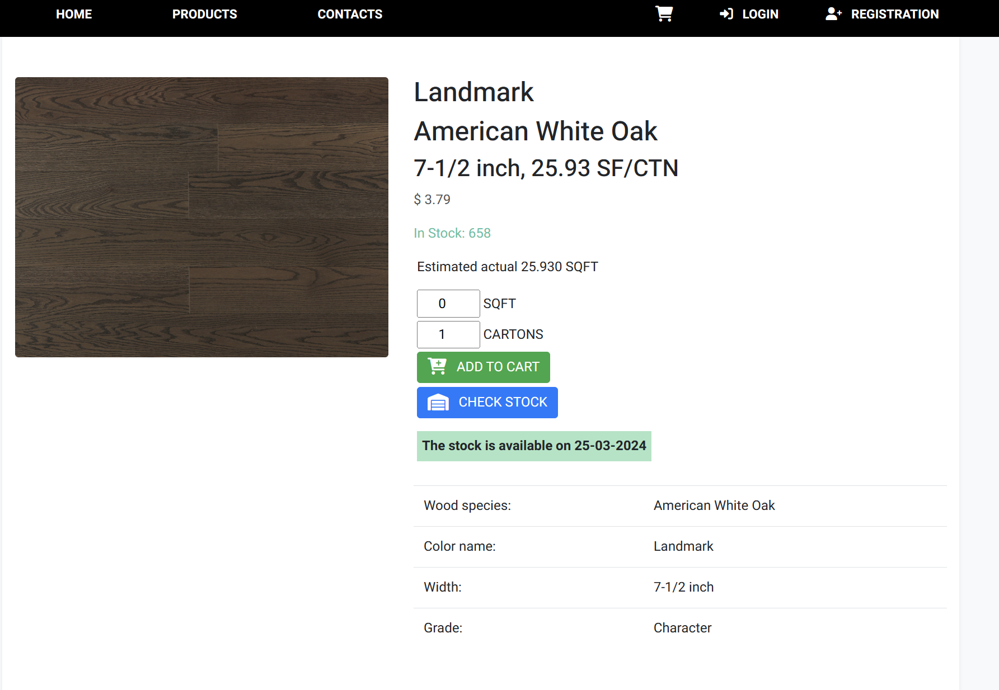
Key Deliveries
Stock look up page
Check stock for information on both Physical and back-order inventory
Show different specifications for Vidar/dealers/public
Need to show detailed information across batches

Slide 4
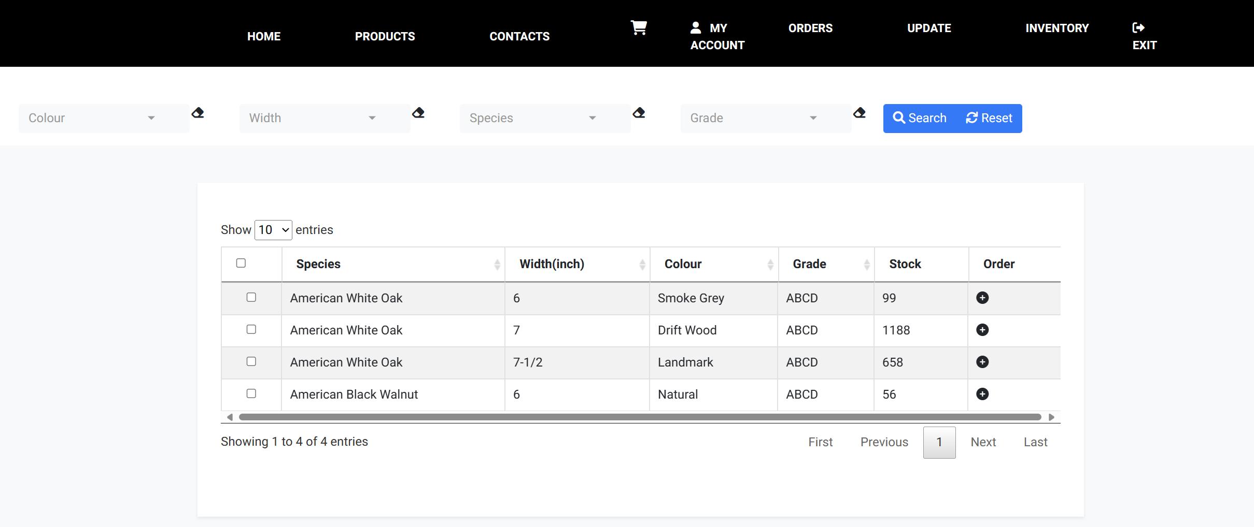
Key Deliveries
Inventory check page(for Vidar/dealers only)
Show all necessary inventory information in the table
Allow easy and fast filtering to locate desired inventory item
Allow easy creation of orders

Slide 5
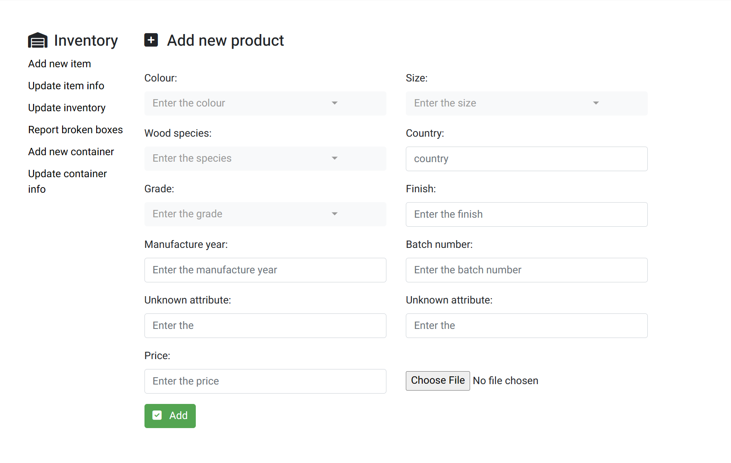
Key Deliveries
Item/Inventory manipulation(for Vidar only)
Allow CRUD operations to item, inventory(both physical and back order)
Implement backend controller for each operation
Design specific web page for each operation

Slide 6
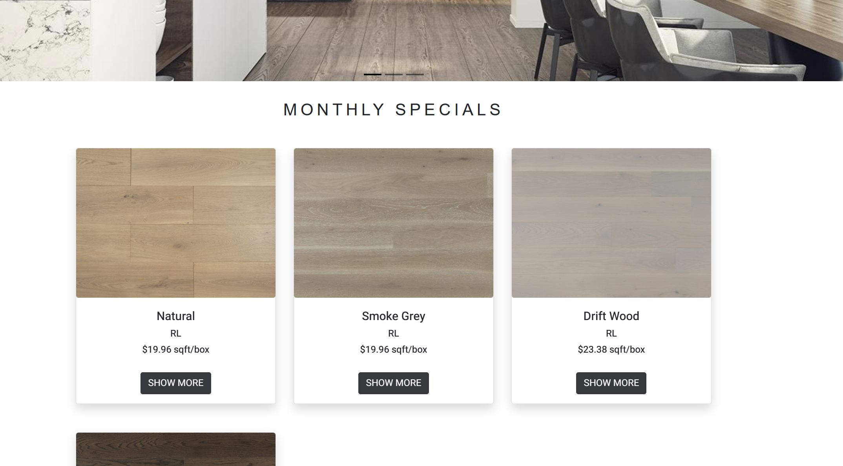
Key Deliveries
Home page for general information and monthly specials
Featured images for slide show
Monthly special products(Need to highlight price drops)
Other general information

Slide 7
Next steps towards version 1.1a
Create an IOS application with existing Java backend.
Create a WeChat mini-program with existing Java backend.

